Slide 1


MEDISAFE
Presented By : TEAM ALPHA CODERS
Invictus | 2025

Slide 2
1
TEAM MEMBERS
NISHANT GOSAVI
SAMARTH ADSARE
SWARAJ PENDHARE
HIMANSHU MATLANI
Invictus | 2025

Slide 3
2
TABLE OF CONTENTS
Problem Statement
Proposed Solution
Architecture
User flow
Future Scope
Invictus | 2025

Slide 4

PROBLEM STATEMENT
3
Medication Adherence Companion
Medication non-adherence is a significant challenge, especially among the elderly population, leading to severe health complications, hospitalizations, and ineffective treatment outcomes. Factors such as cognitive decline, complex medication regimens, and lack of proper support often cause patients to forget or deviate from their prescribed treatment plans.
To address this issue, there is a need for a Privacy-Oriented Mobile Application that helps patients effectively manage their medication schedules, enhances adherence, and provides real-time notifications to caregivers or family members in case of missed doses. The solution should prioritize user privacy while offering intuitive features like smart reminders, medication tracking, AI-driven adherence insights, and secure data management.

Slide 5
PROPOSED SOLUTION
4
1) Smart Medication and Reminders
Voice based reminder system.
Location-based alerts.
Integration with Google Assistant.
2) Caregiver and Emergency Support
Real-time notifications to caregivers
Geo-Tag support for emergency medical help.
In-App ambulance support.
Invictus | 2025
3)AI-driven Insights
Symptoms logging and health trend Analysis
Drug interaction detection to avoid Harmful Combination
Alternative Drugs recommender
4) Incentivise daily-usage
Give points to the users on the basis of daily login and tracking through our app
Give them discounts on the next weekly/monthly medication purchase
5)Multi-Platform Support
Cross-platform Flutter app for Android, iOS, and Web.
Wearable & IoT Integration (smartwatches, smart pill dispensers).
Multilingual support & accessibility features (Braille, sign language).

Slide 6
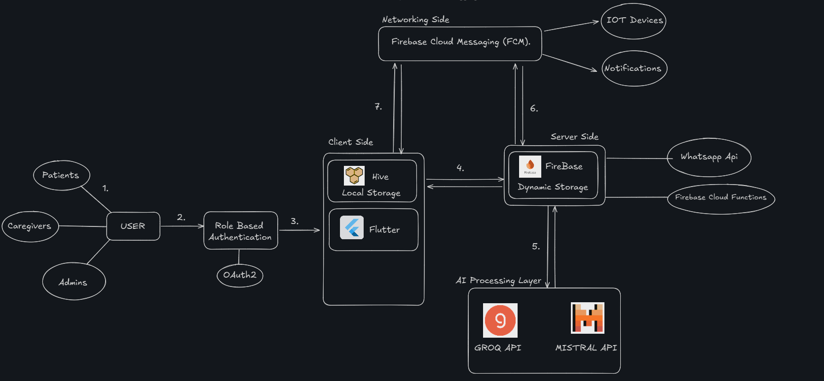
SYSTEM ARCHITECTURE
5

Slide 7
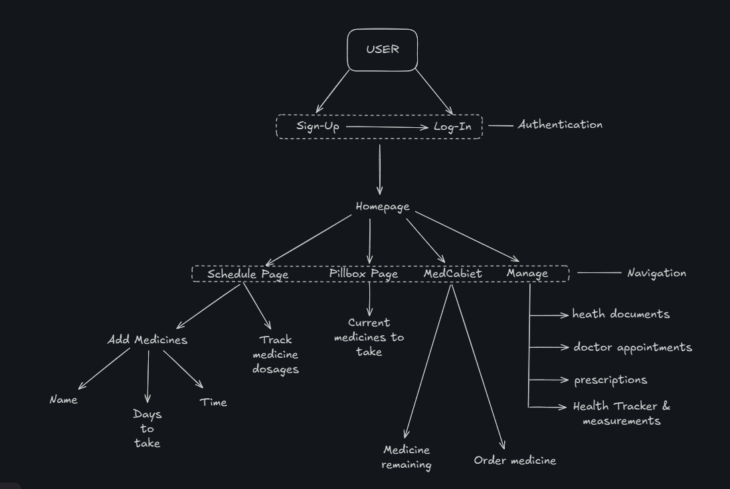
USERFLOW
6

Slide 8
FUTURE SCOPE
7
AI-Powered Smart Reminders – Use ML models to predict adherence patterns and suggest optimal medication schedules based on user habits.
Voice-Based Assistance – Integrate with Alexa, Google Assistant, Siri to remind users via voice commands.
Drug Interaction & Side Effect Warnings – Implement AI-based prescription safety analysis to prevent harmful drug combinations.
Smart Pill Dispensers – Sync with automated pill dispensers to dispense correct doses and send alerts when medications are skipped.
Wearable Health Monitoring – Connect to Apple Watch, Fitbit, Google Fit to monitor heart rate, BP, glucose levels, and adjust medication plans accordingly.
Bluetooth/NFC-Powered Reminders – Enable reminders when users are near their medicine storage area using IoT tags.

Slide 9
8
THANK YOU!
Invictus | 2025

